Slide 1

DATA SPLITTING AND MODEL SELECTION

Slide 2



Data splitting and model selection
HOUSTON, WE HAVE A PROBLEM!!!
The current model (linear model), has been trained using all your data.
You can compute your model performance, but you are not able to quantify up to which extent your model will generalize correctly to unseen data.
If you use new data to make predictions, then you don’t have the real values for the variable to predict!!!
What we can do then?

Slide 3
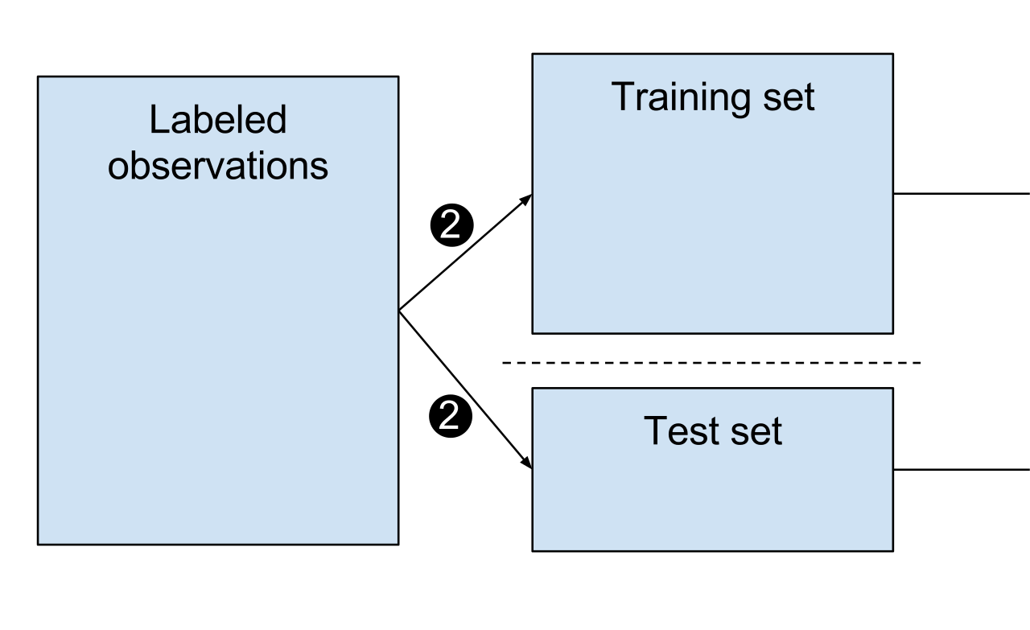
Data splitting and model selection
Split our original data in two sets:
Train and test sets:
Train set: 70-80% of the total data
Test set: 30-20% of the total data
How we decide in which set we place each row of our dataset?
Mostly at random except some specific situations
Now you train the model using the “train set” and you make predictions on the “test set”
Then you select the best model based on the best performance on the “test set”

Slide 4
Data splitting and model selection
Using sklearn to perform data splitting and model generation:
from sklearn.model_selection import train_test_split
X_train, X_test, y_train, y_test = train_test_split(X, Y, test_size=0.3, random_state=100)
lm = linear_model.LinearRegression()
lm.fit(X_train,y_train)
y_pred_train = lm.predict(X_train)
y_pred_test = lm.predict(X_test)
r2_score_train = r2_score(y_pred_train, y_train)
r2_score_test = r2_score(y_pred_test, y_test)

